Slide 1
Markov Models
Understanding Reasoning Over Time & Space

Slide 2
What We Will Cover Today
01
Reasoning Over Time & Space
04
Chain Rule & Markov Models
02
Markov Model Introduction
05
Weather Chain Example
03
Joint Distribution
06
Stationary Distributions

Slide 3
Reasoning Over Time or Space
The Core Question:
Key Idea
How do things change over time? And how can we predict what comes next?
State at t=1
🌤
Weather
▼
Sunny → Cloudy → Rainy
State at t=2
💰
Stock Market
▼
Up → Down → Sideways
State at t=3
Language
▼
🗣
State at t=4
Word follows word in sentences

Slide 4
Markov Models — Introduction
📖 A Markov Model is a mathematical system that transitions between a finite set of states, where the
next state depends ONLY on the current state, not the past. This is the "Markov Property."
The Markov Property
States (S)
Start State (π)
P(Xₜ₊₁ | X₁, X₂, ..., Xₜ)
All possible situations the system can be in
Initial probability distribution over states
= P(Xₜ₊₁ | Xₜ)
💡 Think of it like
Only the current state matters!
Transitions (T)
Probabilities of moving between states
amnesia: the system forgets its history!
✅ Memoryless: If it's raining today, the chance of rain tomorrow depends ONLY on today, not whether it rained last week, last month, etc.

Slide 5
Joint Distribution of a Markov Model
What is the probability of an entire sequence of states?
Joint Distribution Formula
P(X₁, X₂, X₃, ..., Xₙ) = P(X₁) × P(X₂|X₁) × P(X₃|X₂) × ... × P(Xₙ|Xₙ₋₁)
P(X₁)
P(X₂|X₁)
P(Xₙ|Xₙ₋₁)
Probability of starting state
Prob of X₂ given X₁
Only depends on previous state
📝 Example:
Sequence: Sunny → Cloudy → Rainy
P(S,C,R) = P(Sunny) × P(Cloudy|Sunny) × P(Rainy|Cloudy)

Slide 6
Chain Rule & Markov Models
General Chain Rule (Probability)
P(X₁,X₂,...,Xₙ) = P(X₁) × P(X₂|X₁) × P(X₃|X₁,X₂) × ... × P(Xₙ|X₁,...,Xₙ₋₁)
With the Markov Property — SIMPLIFIED!
P(X₁,X₂,...,Xₙ) = P(X₁) × P(X₂|X₁) × P(X₃|X₂) × ... × P(Xₙ|Xₙ₋₁)
Without Markov
With Markov
Each state depends on ALL previous states
Very complex! Grows exponentially.
VS
Each state depends ONLY on the previous one
Simple! Each term is just P(Xₜ | Xₜ₋₁)

Slide 7
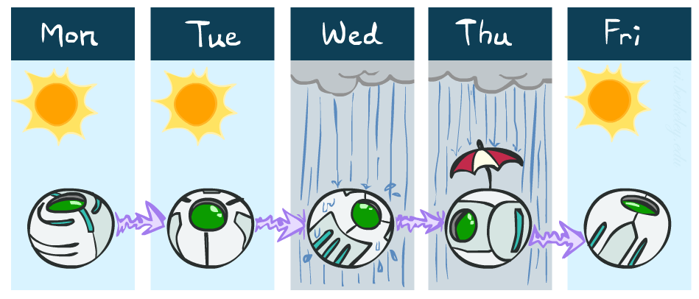
Example Markov Chain: Weather
States: X = {rain, sun}
Initial distribution: 1.0 sun
CPT P(X_{t} | X_{t-1}):
Two new ways of representing the same CPT
X_{t-1} | X_{t} | P(X_{t}|X_{t-1})
sun | sun | 0.9
sun | rain | 0.1
rain | sun | 0.3
rain | rain | 0.7
0.9
0.3
0.9
rain
sun
sun
sun
0.1
0.3
rain
rain
0.7
0.7
0.1

Slide 8
Example Markov Chain: Weather
0.9
Initial distribution: 1.0 sun, 0.0 rain
Transition probabilities/ matrix
What is the probability distribution after one step?
Initial probability x Transition probabilities
0.3
rain
sun
From \ To | ☀️ Sun | ☁️ Rain
☀️ Sun | 0.9 | 0.1
☁️ Rain | 0.3 | 0.7
0.7
0.1

Slide 9
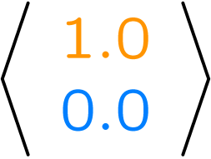
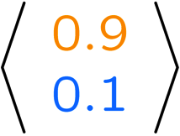
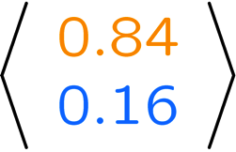
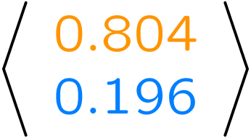
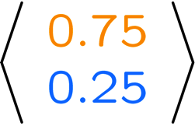
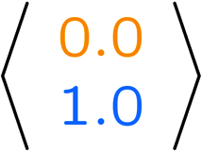
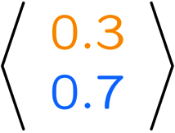
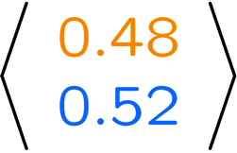
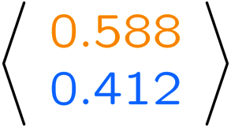
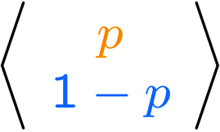
Example Run of Mini-Forward Algorithm
From initial observation of sun
From initial observation of rain
From yet another initial distribution P(X₁):
P(X₁)
P(X₂)
P(X₃)
P(X₄)
P(X∞)
P(X₁)
P(X₂)
P(X₃)
P(X₄)
P(X∞)
…
P(X₁)
P(X∞)

Slide 10
Example Markov Chain: Weather (3 states)
↺ stay sunny
↺ stay cloudy
↺ stay rainy
0.7
0.4
0.5
☀️
Sunny
☁️
Cloudy
🌧
Rainy
0.2 →
0.3 →
← 0.3
← 0.3
Sunny → Rainy: 0.1 (rare direct transition)
Rainy→ Sunny: 0.2 (rare direct transition)

Slide 11
Transition Probabilities
How do we represent 'the chance of going from state A to state B'?
Notation: Transition Probability
⚠️ Key Rule
T(s → s') = P(Xₜ₊₁ = s' | Xₜ = s)
All outgoing probabilities
must sum to 1:
Prob of going to s' given currently in s
∑ T(s → s') = 1
Example: 3-State Weather Transition Matrix
From \ To | ☀️ Sunny | ☁️ Cloudy | 🌧 Rainy
☀️ Sunny | 0.7 | 0.2 | 0.1
☁️ Cloudy | 0.3 | 0.4 | 0.3
🌧 Rainy | 0.2 | 0.3 | 0.5

Slide 12
Stationary Distributions
📖 Definition
A stationary distribution π is a probability distribution that does NOT CHANGE when you apply the transition matrix.
The Key Equation
🪣 Intuition: Steady State
π = π · T
Imagine water flowing into and out of buckets. A stationary distribution is when each bucket maintains the same water level over time, means inflow = outflow.
π stays the same after one step!
Properties of a Stationary Distribution
✅ All values are non-negative (probabilities ≥ 0)
✅ All values sum to exactly 1: ∑πᵢ = 1
✅ It's the long-run proportion of time in each state

Slide 13
Finding the Stationary Distribution
Step-by-Step: 2-State Weather Example (Sunny & Rainy only)
Transition Matrix T
Setup Equations (π = π·T)
Sunny Rainy
Let π = [πₛ , πᵣ] (Sunny & Rainy probabilities)
Sunny [ 0.8 0.2 ]
Eq 1: πₛ = 0.8·πₛ + 0.4·πᵣ
Rainy [ 0.4 0.6 ]
Eq 2: πᵣ = 0.2·πₛ + 0.6·πᵣ
Rows must sum to 1 ✓
Eq 3: πₛ + πᵣ = 1 (must sum to 1)
✅ Solution
From Eq1: 0.2·πₛ = 0.4·πᵣ → πₛ = 2·πᵣ
Substituting in Eq3: 2·πᵣ + πᵣ = 1 → πᵣ = 1/3 ≈ 0.33 and πₛ = 2/3 ≈ 0.67
π = [0.67, 0.33] → In the long run: 67% Sunny days, 33% Rainy days!

Slide 14
Key Takeaways
Markov Property
Chain Rule Simplified
1
4
The future depends ONLY on the present, not the past (memoryless).
Markov Property lets us drop all history — only one previous state needed.
Joint Distribution
Stationary Distribution
2
5
P(sequence) = P(X₁) × P(X₂|X₁) × P(X₃|X₂) × ...
The long-run stable distribution π where π = π·T.
Transition Matrix
Convergence
3
6
Stores all probabilities T(s → s'). Each row sums to 1.
Any Markov chain (under mild conditions) converges to π over time.

Slide 15
Quick Reference: Formulas & Symbols
Markov Property
P(Xₜ₊₁ | X₁,...,Xₜ) = P(Xₜ₊₁ | Xₜ)
Joint Distribution
P(X₁,...,Xₙ) = P(X₁) · ∏ P(Xₜ₊₁|Xₜ)
Stationary Dist.
π = π · T and ∑ πᵢ = 1
Transition Prob.
T(s,s') = P(Xₜ₊₁ = s' | Xₜ = s)

Slide 16
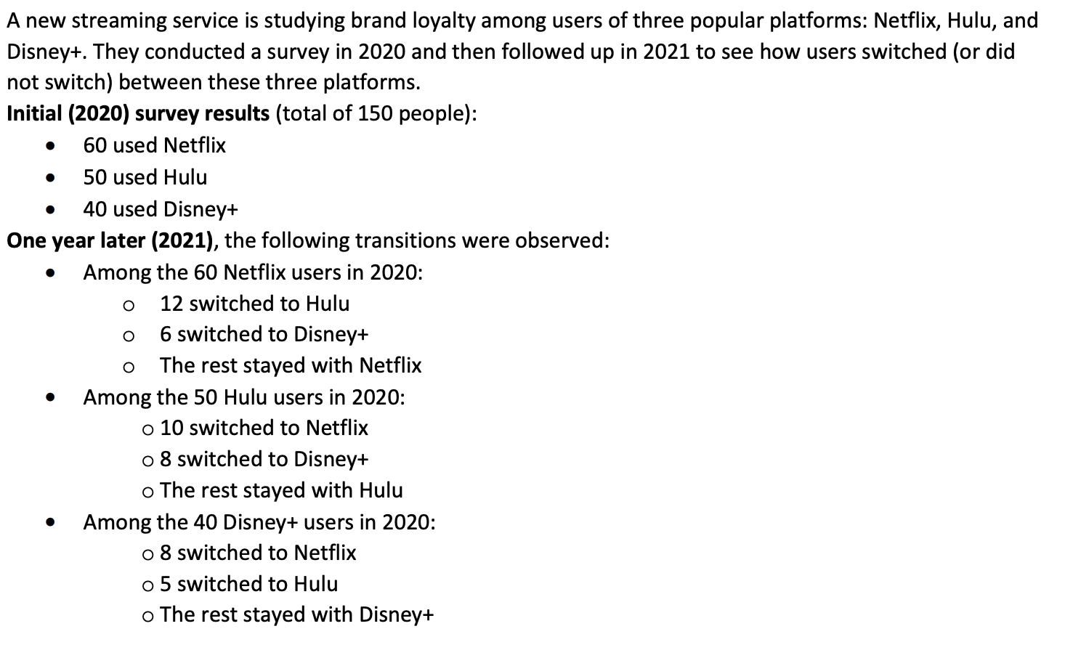
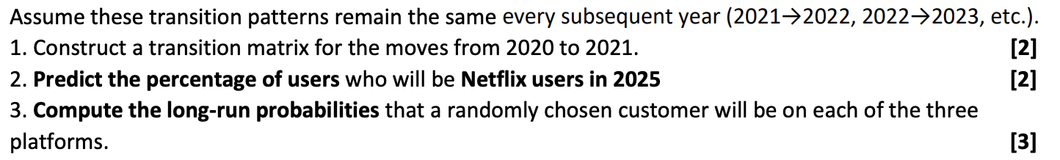

Slide 17
Problem Statement
Streaming platforms: Netflix (N), Hulu (H), Disney+ (D)
2020 users:
Netflix = 60
Hulu = 50
Disney+ = 40
Total = 150
questions
1. Construct the transition matrix.
2. Predict Netflix users in 2025.
3. Compute the long-run (stationary) probabilities.

Slide 18
Step 1: Organize Transition Data
Netflix users (60):
• 12 -> Hulu
• 6 -> Disney+
• 42 stay Netflix
Hulu users (50):
• 10 -> Netflix
• 8 -> Disney+
• 32 stay Hulu
Disney+ users (40):
• 8 -> Netflix
• 5 -> Hulu
• 27 stay Disney+

Slide 19
Step 2: Compute Transition Probabilities
Netflix row:
P(N→N)=42/60=0.70
P(N→H)=12/60=0.20
P(N→D)=6/60=0.10
Hulu row:
P(H→N)=10/50=0.20
P(H→H)=32/50=0.64
P(H→D)=8/50=0.16
Disney+ row:
P(D→N)=8/40=0.20
P(D→H)=5/40=0.125
P(D→D)=27/40=0.675

Slide 20
Step 3: Construct the Transition Matrix (ans of Q1)
Rows = Current Platform
Columns = Next Year's Platform
P = [0.70 0.20 0.10]
[0.20 0.64 0.16]
[0.20 0.125 0.675]
Each row sums to 1

Slide 21
Step 4: Initial State Distribution (2020)
Convert user counts to probabilities:
Netflix = 60/150 = 0.40
Hulu = 50/150 = 0.333
Disney+ = 40/150 = 0.267
π₂₀₂₀ = [0.40, 0.333, 0.267]

Slide 22
Step 5: Predict 2021 Distribution
π₂₀₂₁ = π₂₀₂₀ P
Netflix:
0.40(0.70)+0.333(0.20)+0.267(0.20)=0.400
Hulu:
0.40(0.20)+0.333(0.64)+0.267(0.125)=0.327
Disney+:
0.40(0.10)+0.333(0.16)+0.267(0.675)=0.274
π₂₀₂₁ ≈ [0.400, 0.327, 0.274]

Slide 23
Step 6: Predict up to 2025
(ans of Q2)
Repeatedly multiply by P:
π₂₀₂₂ ≈ [0.402, 0.321, 0.277]
π₂₀₂₃ ≈ [0.403, 0.319, 0.278]
π₂₀₂₄ ≈ [0.404, 0.318, 0.278]
π₂₀₂₅ ≈ [0.404, 0.318, 0.278]
Answer:
Netflix users in 2025 ≈ 40.4%

Slide 24
Step 7: Stationary Distribution Setup
Let the stationary distribution be:
π = [x, y, z]
Condition:
π = πP
and
x + y + z = 1

Slide 25
Step 8: Derive the Equations
From π = πP:
x = 0.70x + 0.20y + 0.20z
y = 0.20x + 0.64y + 0.125z
Rearrange:
3x - 2y - 2z = 0—--------(1)
360y = 200x + 125z—-----(2)
We know,
x + y + z = 1—-------(3)

Slide 26
Step 9: Solve the Equations
From eq 1:
3x = 2(y+z)
Since y+z = 1-x: (from eq 3)
3x = 2(1-x)
5x = 2
x = 0.4
Then replace x in eq 3:
y+z = 0.6

Slide 27
Step 10: Find y and z
Substitute x in eq 2:
360y = 200(0.4) + 125z
360y = 80 + 125z
Substitute z = 0.6 - y:
360y = 80 + 125(0.6 - y)
485y = 155
y = 0.320
z = 0.280

Slide 28
Final Answer (ans of Q3)
Stationary Distribution:
π = [0.400, 0.320, 0.280]
Interpretation:
Netflix = 40.0%
Hulu = 32.0%
Disney+ = 28.0%
Long-run market shares converge to these values.

